Slide 1

Unit -4 HAZARD IDENTIFICATION TECHNIQUES

Slide 2
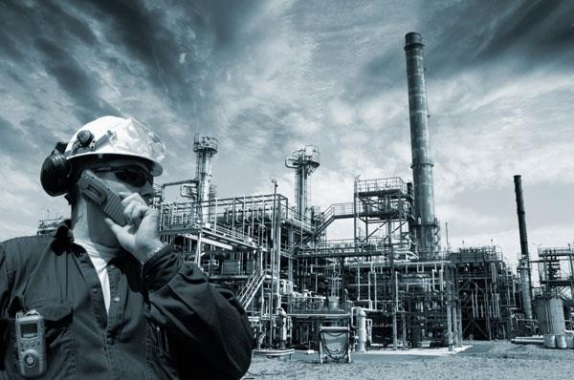
Hazard Analysis, prevention and safety management
Contents :
Preliminary Hazard analysis (PHA)
Detailed Hazard analysis

Slide 3
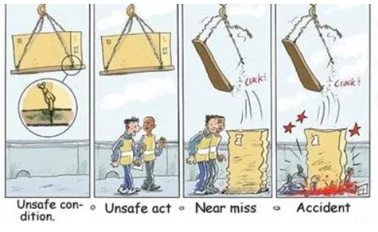

Slide 4

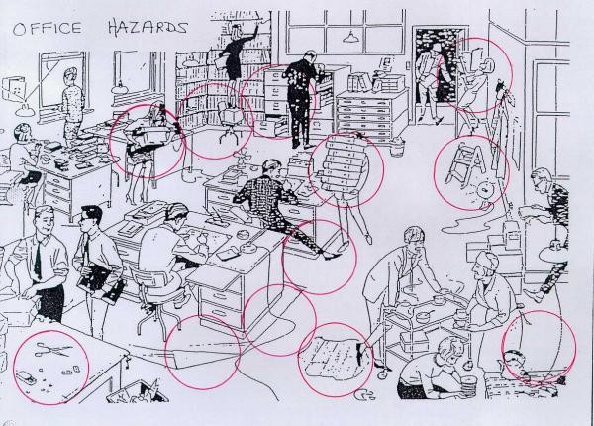
Example of Hazards at Office workplace

Slide 5
Source of Hazard :
5M
Man | Unsafe acts
Machinery | Installation, layout and design of equipment
Materials | Substances such as chemicals and gases use in the workplace
Method | The way people carry out their work
Media | Workplace condition e.g. air quality, ventilation, lighting, noise, vibration, etc.
Hazard Analysis :
A systematic process of identifying hazards and recommending
correction action.
2 approaches :
 | Detailed hazard
Preliminar | y | analysis
hazard analysis

Slide 6
Preliminary Hazard analysis (PHA)
Conducted to identify potential hazards and prioritize them according to the :
probability of an accident or injury being caused by the hazard.
severity of injury, illness or property damage that could result if the hazard caused an accident.
PHA can serves 2 purposes :
it can expedite bringing the new system on line, but at a substantially reduced risk of injuring workers.
it can serve as a guide for a future detailed analysis.
Experience and related expertise are important factors in conducting a preliminary review.

Slide 7
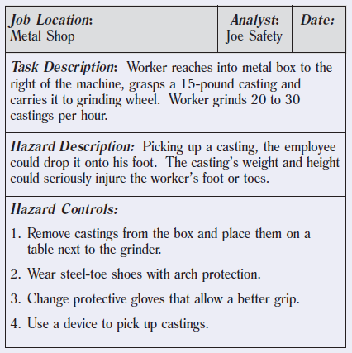
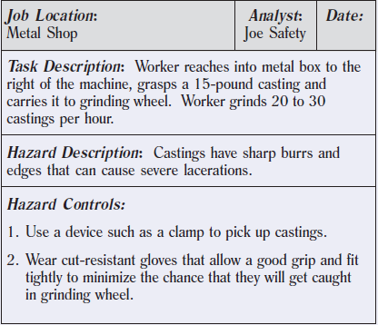
Preliminary Hazard analysis (PHA)
Example Job hazard analysis form

Slide 8
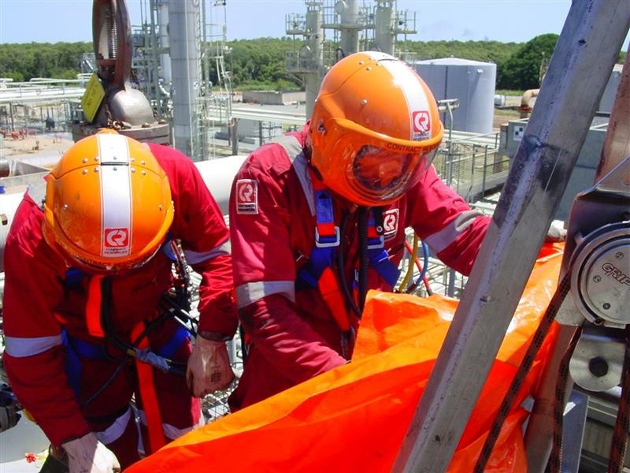
Detailed Hazard Analysis
Conducted for the potential exists for serious injury, multiple injuries or illness.
The most widely used of these are as follow:
Failure Mode and Effect of analysis (FMEA)
Hazard and operability review (HAZOP)
(3) Fault tree analysis (FTA)
(4) Risk analysis

Slide 9
Risk Analysis
Risk Analysis
Risk is the combination of the likelihood and severity of a specified hazardous event occurring.
In Mathematical term, risk can be calculated by equation :
RISK = Likelihood × Severity
Risk analysis method :
Step 1 : Gather information about each hazard identified.
Step 2 : Use the information to assess the likelihood and severity of each hazard.
Step 3 : produce a qualitative risk table.

Slide 10
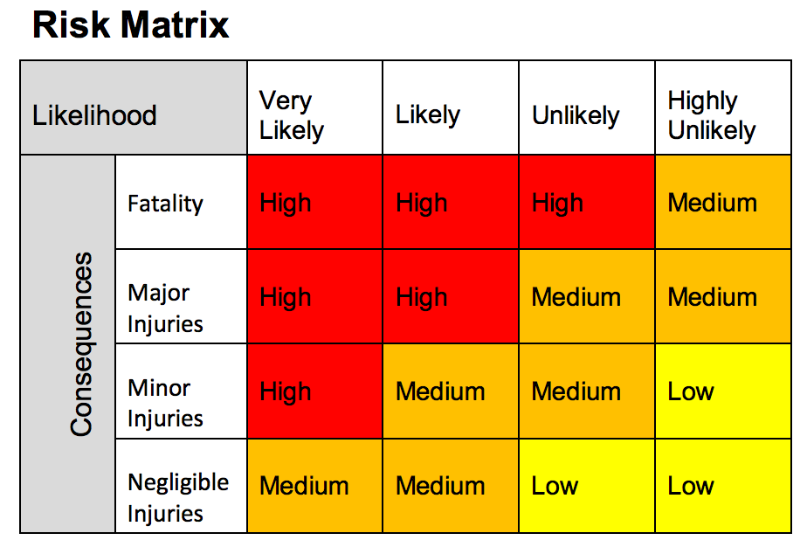

Slide 11
Detailed Hazard Analysis
(4) Risk Analysis
EXAMPLE :
“Likelihood” “Severity”
Very likely (Daily) | 4
Likely (Weekly) | 3
Unlikely (Monthly) | 2
Highly unlikely (yearly) | 1
Fatality (or permanent disability) | 4
Major Injuries (> 4 days MC) | 3
Minor Injuries (< 4 days MC) | 2
Negligible Injuries (First Aid and Near Misses) | 1
Calculation : If likelihood of a hazard is estimated = 2, and if severity is
estimated =4. So, Risk = 2× 4 = 8
Produce the Risk Table :
No. Hazard | Hazard | Likelihood | Severity | Risk
1 | A | 4 | 4 | 16
2 | B | 1 | 1 | 1

